Slide 1
Manhattan, New York: Education, Wage, and Hours Worked
By: Sylvia Pak

Slide 2
Abstract
Examine NYC’s Manhattan open positions and job descriptions
Purpose - Does education impact:
hourly wage
hours worked per week
Models used:
Clean data, find average of wage and hours per week
Bar charts
Multiple Linear Regression
Kernel Density Estimator (KDE) plots
Split data into testing and training sets
Decision Tree Classifier
Results:
High School Diploma = Less than average wage and hours
Associate’s Degree = Higher wage and less hours than average
Bachelor’s & Master’s Degree = Above average wage and hours

Slide 3
Introduction
Examine Manhattan, New York from the City of New York public data.
Use data to determine if Higher Education is imperative for increasing wages and working less hours specific to Manhattan, NY.
Project Workflow & Process
Prepare and clean data to specify Manhattan.
Compare Education Requirement to the # of hours worked and hourly pay using the mean (average).
Identify the data using computational methods and data visualizations:
Bar graphs, KDE plots, Multiple Regression, Train-Test split data, and Decision Tree

Slide 4
The Problem (Context)
What’s the Problem?
Can certain educational background impact the number of hours worked per week and hourly wage?
Can we use the given data to determine if higher education leads to better “Work-Life Balance” in terms of higher wages and less work hours?
Understanding job descriptions in Manhattan, NY:
Insight to what is the expectation of open positions

Slide 5
Purpose of the Study
Education and its impact on work-life balance.
less work hours
higher hourly pay
If higher education is needed to minimize the wage gap in Manhattan, NY.
Desired Outcome:
Having a Bachelor’s Degree allows higher wages and less work
Society’s emphasis on further education, specifically college
Master’s Degree is very expensive. We want to avoid expenses.

Slide 6
Project Description: Hypothesis
What the study will try to measure:
Individuals with a Bachelor's degree will be offered:
Higher wage and work less hours than those with a High School Diploma and/or Associate's Degree.
Master's Degree will have higher wages and more hours of work.
Major Question:
Is Education correlated to wage and hours of work per week?

Slide 7
Project Description: Workflow
Map The System
Use City of New York Data:
The data includes:
All New York boroughs
Positions
Education requirements
Wage
Hours per week
etc

Slide 8
Project Description: Workflow
Define Suitable Metrics
Clean the data set to show:
Borough - Manhattan
WageMin
Education Required
Which education level is listed
Remove none values. These are values that are not specific.
Min Hours Per Week
Max Hours Per Week
Clear data of:
Null values
Columns not related to study

Slide 9
Project Description: Workflow
Selecting Modeling Tools
Clean data
Calculate the mean of wages and hours per week
Create bar graphs of average - for visualization purpose
Education Requirement changed to numerical values - ordinal data
Need this to perform:
Multiple Linear Regression
Bar charts and KDE plots
Split data into testing and training sets
Decision Tree Classifier

Slide 10
Project Description: Methods
Selecting Mathematical and Computational Methods and Modeling Data

Slide 11
Project Description: Methods
Mathematical and Computational Methods
Find Mean (Average)
Find the mean (average) for each Education Required
Create new column for average:
Wage
Hours Per Week
Create Bar Graphs to visualize the average

Slide 12

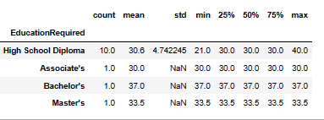
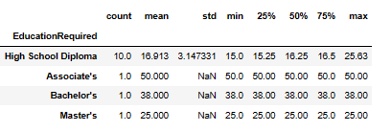
Overall Average
Average Hours Per Week
Average Wage

Slide 13
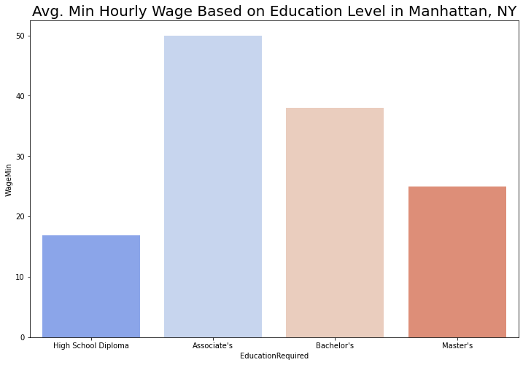

Slide 14
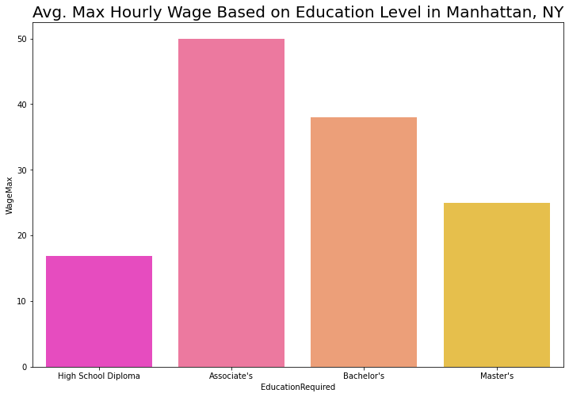

Slide 15
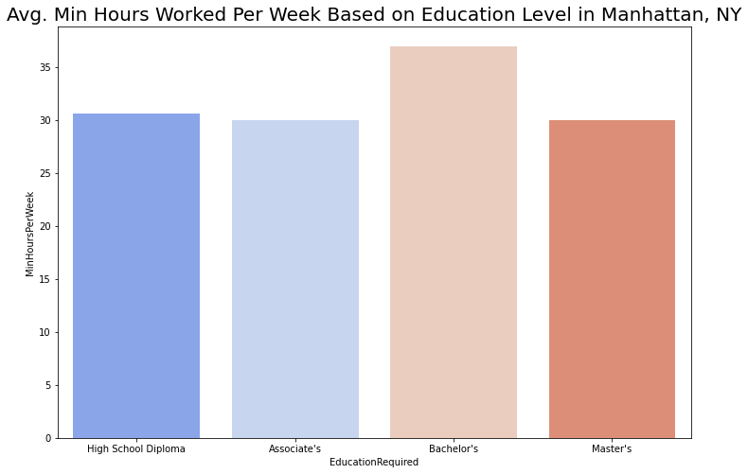

Slide 16
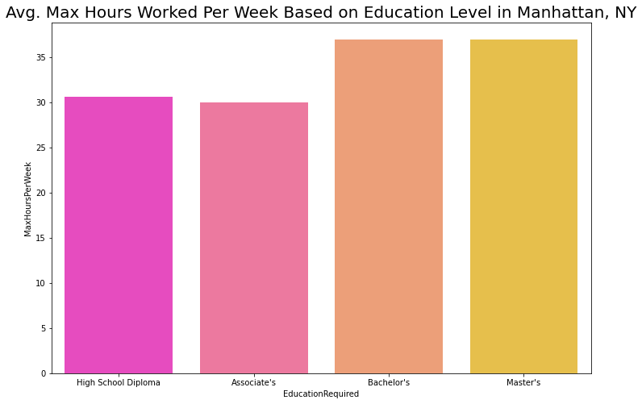

Slide 17
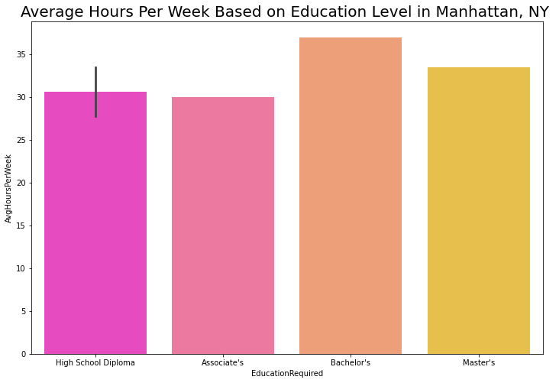

Slide 18


Slide 19
Mathematical and Computational Methods
Mathematical/ Algorithms for Predictions:
Multiple Linear Regression
Change Education Required Column into integers
Education Level is ordinal data.
Kernel Density Estimator (KDE) Plots
Heat Map (Correlation)
Decision Tree (Categorical Classification)

Slide 20
Multiple Linear Regression
Find relationship between:
Education Required (Dependant variable)
Average Wage (Independent variable)
Average Hours Per Week (Independent variable)
Regression Score: .37740… (this is low, use another method)

Slide 21
Kernel Density Estimate (KDE) Plot
Based on both plots:
Majority of the data is from High School Diploma
Lowest for wage and hours per week.
Degrees > High School Diploma = Less density
Positive correlation for Education in relation to wage and weekly work hours.

Slide 22
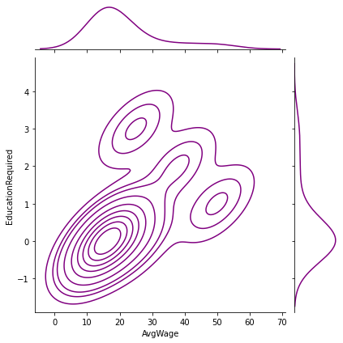
KDE Plot: Average Wage and Education Required
Visualize and show the probability density of the Average Hourly Wage in relation to Education Requirement.

Slide 23
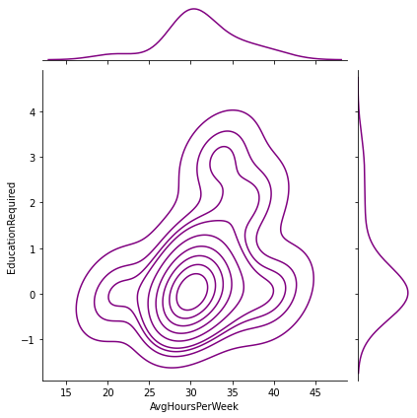
KDE Plot: Average Hours Per Week and Education Required
Visualize and show the probability density of the Average Hours Per Week in relation to Education Requirement.

Slide 24
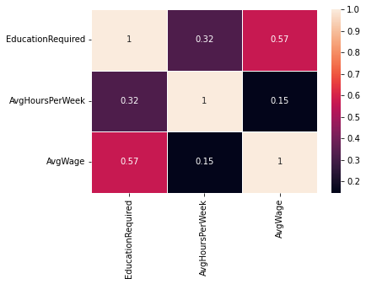
Heat Map: Correlation
Average Wage and Education higher than .5 correlation
Average Hours Per Week and Education show lower than .5 correlation

Slide 25
Decision Tree: Explanation
Accuracy: 0.75/ 75%
Tree breakdown based on Education category is above or below the average of the data.
Position openings requiring Associate's Degree and higher offers above average wages.
Associate’s degree requirement is above average for wage and below average for hours per week.
Bachelor's Degree requirement has higher wages and higher average work hours per week.

Slide 26
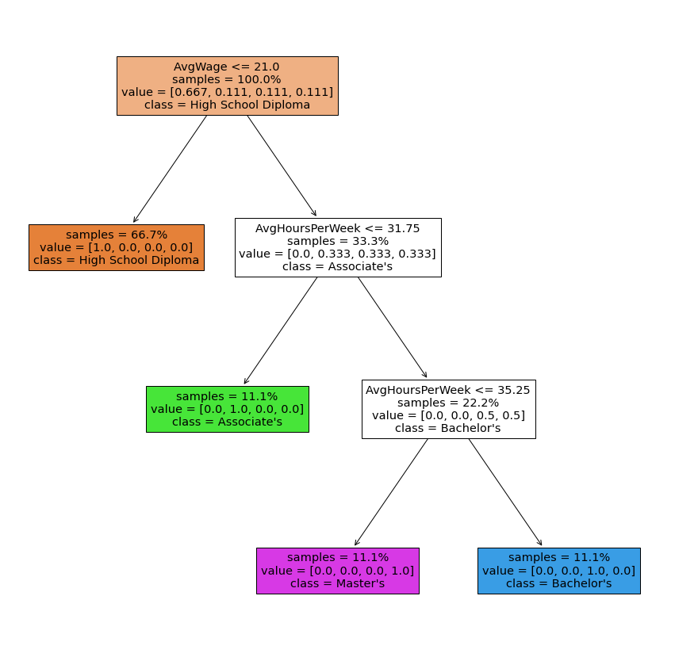
Decision Tree

Slide 27
Project Description: Analysis
Associate’s Degree = Above average wage, less hours than degrees higher
High School Diploma = Below average hourly wage and hours
Bachelor’s Degree = Above average wage and hours
Master’s Degree = Above average wage and hours
Less hourly wage than Associate’s and Bachelor’s Degrees
More hours worked than Associate’s and near similar hours of work to Bachelor’s Degree

Slide 28
Project Description : Results
The accuracy for the decision tree is 75%, higher than 50%.
Tree Breakdown: if Education category is above or below the average of the data.
Associate's Degree has a higher average hourly wage and below hours work per week compared to Bachelor’s and Master’s.
Bachelor's Degree has higher wages and higher average work hours per week.

Slide 29
Conclusion
Importance of the study:
Show if education is an important factor in work life balance in terms of less hours of work per week and higher hourly wages.
The study shows that the open positions requiring an Associate's Degree is the most promising degree requirement of the four.

Slide 30
Bibliography
- United States, NYC Open Data. Https://Data.cityofnewyork.us/Business/Workforce1-Job-Listing/ay9k-Vznm, Department of Small Business Services (SBS), 2020. https://data.cityofnewyork.us/resource/ay9k-vznm.json.
- Deisenroth, M. P., Faisal, A. A.,, Ong, C. S. (2020). Mathematics for Machine Learning. Cambridge University Press.
- Bishop, Christopher M. 2006. *Pattern Recognition and Machine Learning*. Springer.
- Bubeck, Sébastien. 2015. Convex Optimization: Algorithms and Complexity. *Foundations and Trends in Machine Learning*, **8**(3-4), 231–357.
- Scikit-learn: Machine Learning in Python, Pedregosa et al., JMLR 12, pp. 2825-2830, 2011.
- Burkov, Adriy. 2019. "The Hundred-Page Machine Learning Book". Andriy Burkov.
*Please add slides as required.

